Slide 1
Lariat CAPSTONE
By Kim Le

Slide 2

Lariat in 2018
Total Revenue: $52,830,207
Total Costs: $26,004,778
Total Profit: $26,825,429
Profit Margin: 51%
81,318 Rentals
4,000 Vehicle Fleets
50 Branches
Notes:
Talk about how impressive this data is and emphasize profit margin as a positive metric since value.

Slide 3

Business Goals for 2019
Increase Revenue by 10%
Increase Profits by 20%
51% to 55% Profit margin
Reduce Costs
3 Possible Strategies to increase revenue and profits, while decreasing costs.
Notes:
The percentages are based on the three strategies that will be covered later in the presentation. Explain how I got the percentages (from combining all the strategies and calculations).

Slide 4

Strategy 1: Increasing Rentals by Including a Promotion
Increase the number of rentals by 15%
81,318 rentals ➜ 93,516 rentals
Example promotion - Applying a 5% discount on rentals
Revenue: $58,113,228
Costs: $26,004,778
Profit: $32,108,450
Profit Margin: 55%
Notes:
Explain how I got these calculations

Slide 5
Notes:
Comparison chart of Baseline vs. Strategy 1

Slide 6
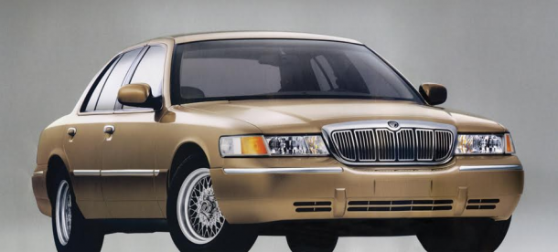
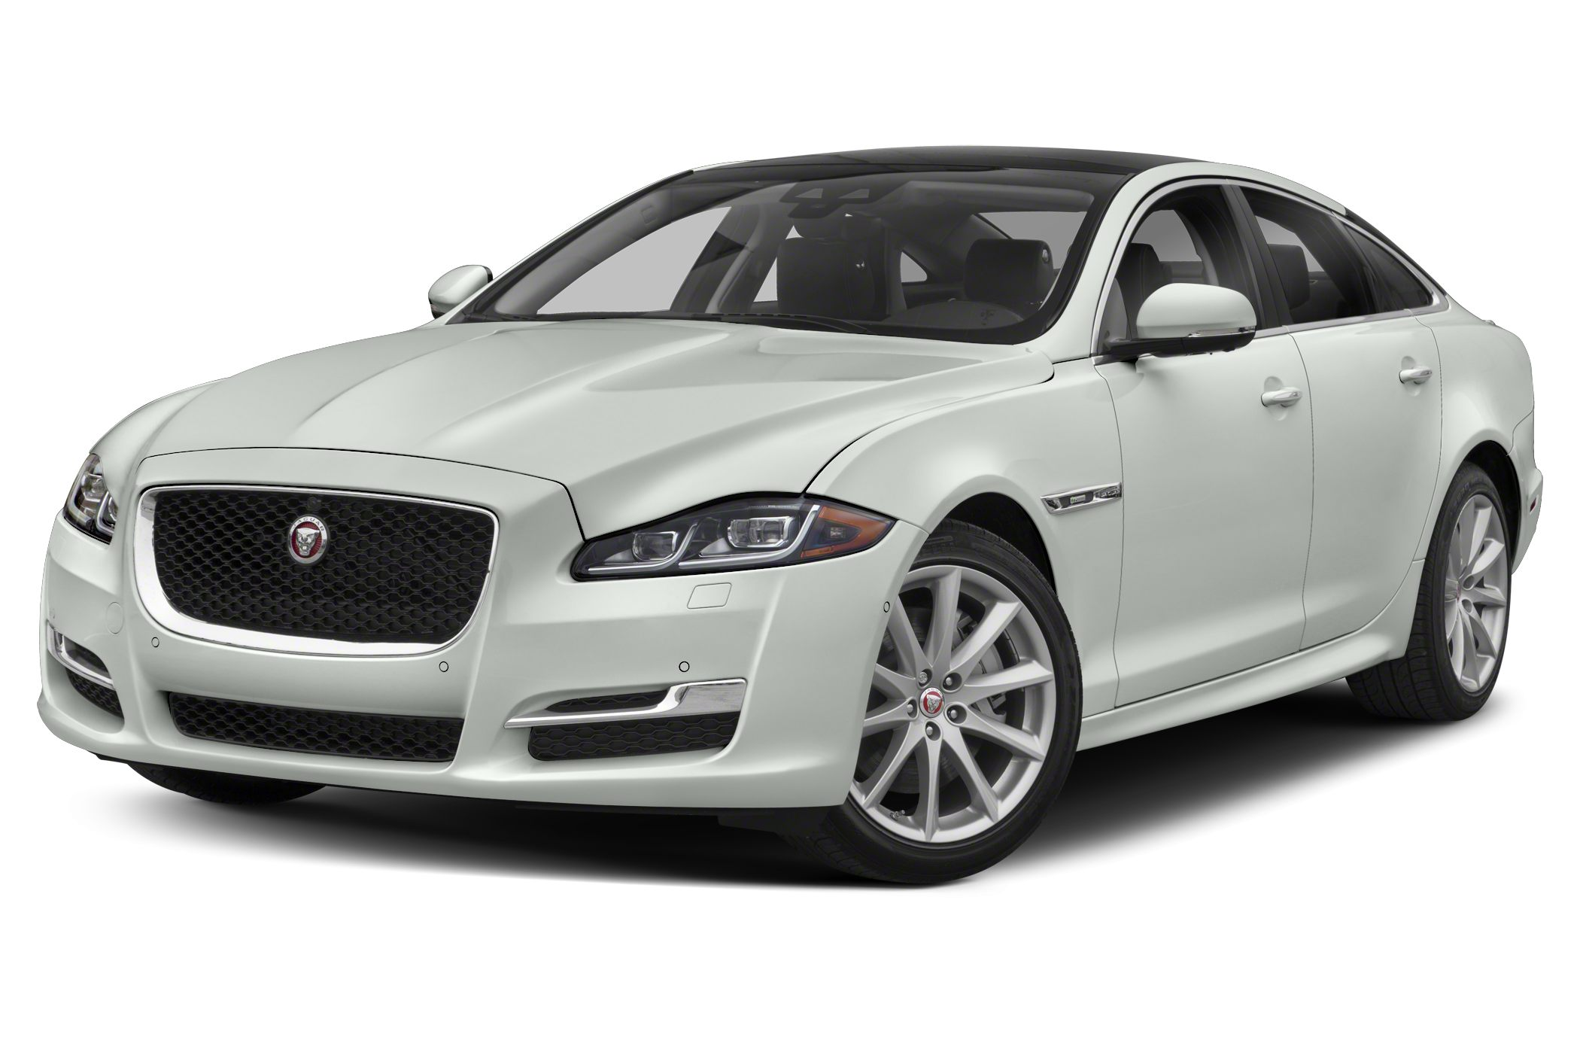
Strategy 2: Remove the 15 Lowest Performing Vehicles
Based on profit margin data
Low performing vehicle = Negative profit margin
Revenue: $52,736,199
Cost: $25,891,805
Profit: $26,844,394
 | Revenue | Cost | Profit
Lowest 15 Performing Cars | $94,008 | $112,972 | -$ 18,964
Notes:
Explain how to get the lowest performing vehicles through profit margins – using a pivot table to rank the 15 worst cars by profit margin.
Two cars in picture that were in the 15 lowest performing vehicles list - 2017 Mercury Grand Marquis and 2018 Jaguar XJ Series

Slide 7
Notes:
Comparison chart of Baseline vs. Strategy 2

Slide 8
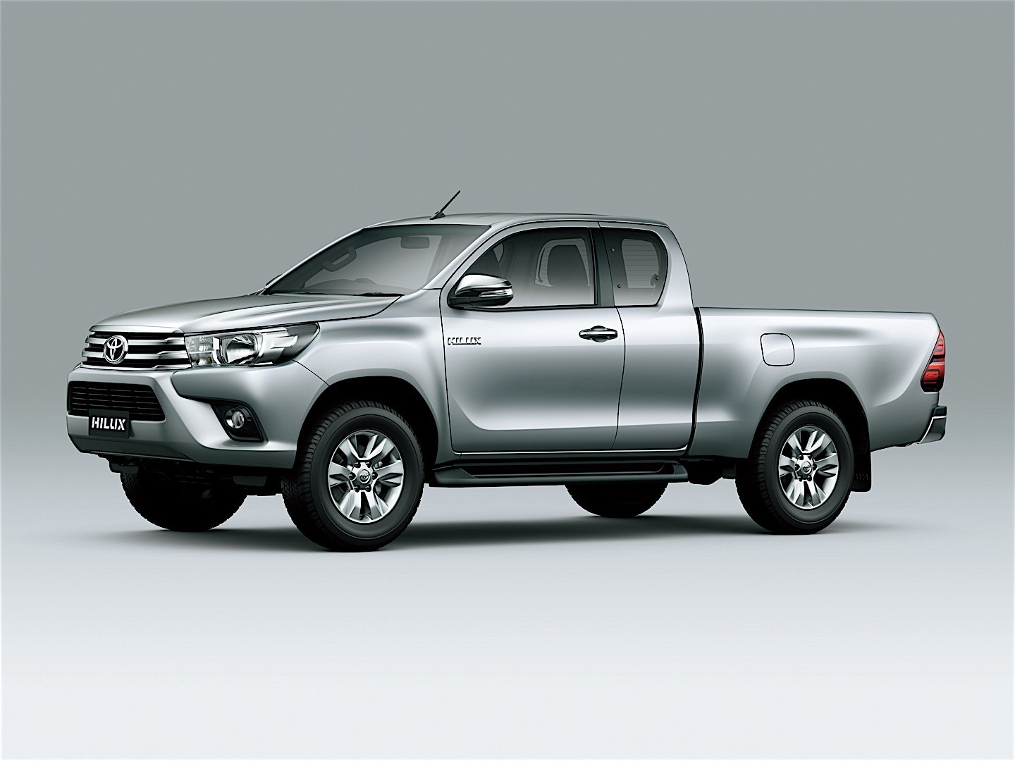
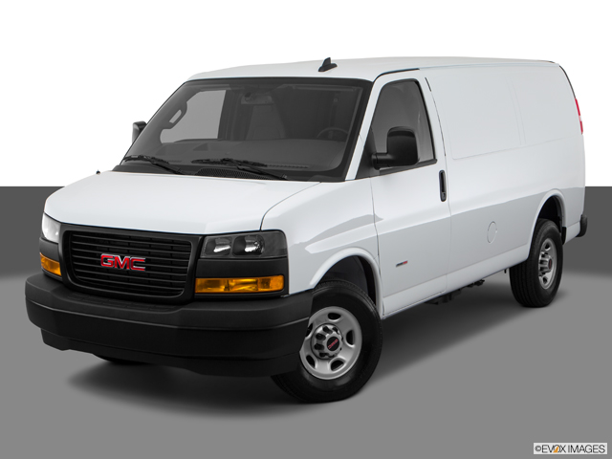
Strategy 3: Add 15 New 2019 Car Models Based on the 15 Best Performing Vehicles
Based on profit margin data
Still removing the 15 worst performing vehicles
High performing vehicle = Positive profit margin
Revenue: $53,036,677.00
Cost: $25,964,680.82
Profit: $27,071,996.18
 | Revenue | Cost | Profit
Highest 15 Performing Cars | $300,478 | $72,875 | $ 227,602
Notes:
Explain how to get the highest performing vehicles through profit margins – using a pivot table to rank the 15 best cars by profit margin.
Two cars in picture that were in the 15 lowest performing vehicles list - 2016 Toyota Xtra and 2018 GMC Savana

Slide 9
Notes:
Comparison chart of Baseline vs. Strategy 2

Slide 10
Combining All Three Strategies
Notes:
Compare the metrics of all three strategies

Slide 11

Summary
In order to reach the business goals for 2019
Increase the number of rentals by 15% and use a promotion as an incentive
Remove the 15 worst performing vehicles
Add 15 new 2019 car models based on vehicles with the highest profit margin
Strategy 1 can also be used solely to reach goals, but there are risks
Cannot go into the assumption promotion will work fully 100%, requires potential A/B testing
Notes:
Explain the risks, as the business cannot be too sure the promotion will be successful on its own.

Slide 12
Questions?

